Slide 1
A Mean Shift-Based Pattern Formation Algorithm for Robot Swarms
Chase Vickery, Sayed Ahmad Salehi
University of Kentucky, Computer Engineering Department
chase.vickery@uky.edu, SayedSalehi@uky.edu
Notes:
Hello everyone, it’s great to be here, my name is Chase Vickery, and I will be talking about a mean shift-based pattern formation algorithm for robot swarms.

Slide 2
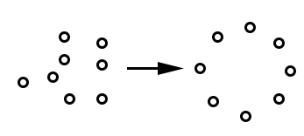
Pattern Formation
Pattern Formation
Difficult
Varied approaches
Goal: Pattern formation that uses mean shift
Idea: Create pattern using data points. Robots perform mean shift to approach.
Notes:
First, I want to quickly address the problem of pattern formation. This task entails getting a group of individual agents to self-assemble into a specified global pattern.
Unfortunately, this can be difficult to accomplish using a distributed method where there is no central control unit for the group.
In our approach to the pattern formation problem, we attempted to use the mean shift algorithm as the basis for deciding how individual agents would move to accomplish this task.
The idea basically boils down to: 1) we define a pattern using a set of coordinate pairs, and 2) robots move towards these pattern points to assemble the pattern

Slide 3
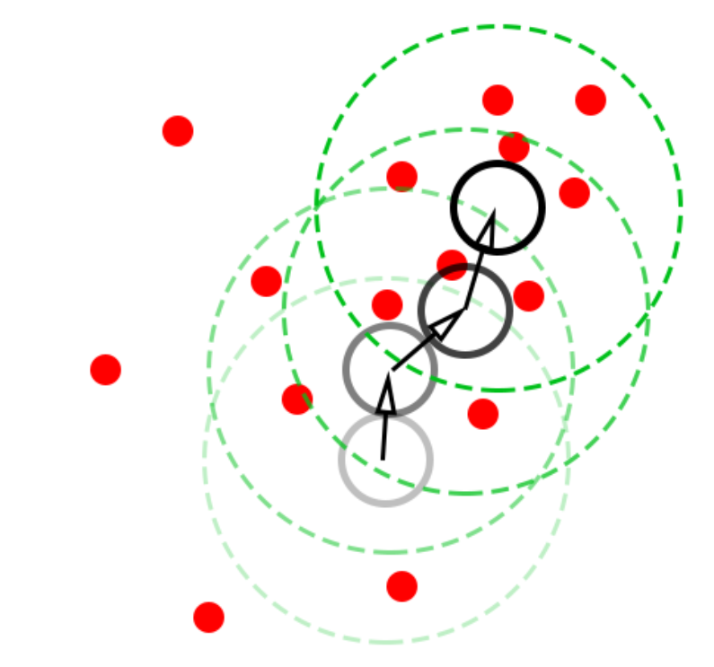
Mean Shift
- Iterative
- Seeks dense data regions
- Kernel window
$$M\left(x\right)−x=\frac{\sum_{p∈P}{K\left(p−x\right)p}}{\sum_{p∈P}{K\left(p−x\right)}}−x$$
Notes:
Knowing the task, we can look a bit closer at the mean shift algorithm that is used to accomplish this.
Mean shift is an iterative algorithm that, in an intuitive sense, seeks regions of denser data. This is done by having a kernel window that is checked for data points, before calculating a weighted average of data point positions relative to the window location. The window is then shifted to that new average position. Which means that, as the window moves, data points may enter or leave the kernel, affecting the path of the window through the data set.
This is a common process used in some computer vision and object tracking tasks.

Slide 4
Pattern Formation + Mean Shift
Goal: Pattern formation that uses mean shift
Idea: Create pattern using data points
Notes:
Describe pattern formation problem: Goal of pattern formation is to get a group of individual agents to assemble into a global pattern using local rules.
Our idea involved building a pattern using data points, while each robot acts using a kernel window to perform mean shift on the pattern points within its window range.
The formation of this idea was mostly on the level of intuition:

Slide 5
Innovations
Two Kernels
Pattern-Seeking
Inter-Robot Repulsion
Adaptive Kernel Size
Notes:
While we are using mean shift for calculating movement, there were still 2 innovations that we had to implement to make it appropriate for the pattern formation task.
The first idea was to have each robot keep track of 2 independent kernels, both of which utilize the mean shift calculation. One kernel is used to identify parts of the pattern around a robot, so that the robot can detect and move towards the pattern. The other kernel is used to identify neighboring robots, which is important for the purposes of pushing robots away from one another to distribute the group of robots around the pattern.
The second concept here was the idea of an adaptive kernel size. This means that the window sizes of these kernels depend on the state and environment of each robot. Our algorithm is such that the size of the window increases when there are no data points within the kernel window and decreases whenever data points are found in the window. The implication for the pattern-seeking kernel is that the robot increases the search range when it has not found any part of the pattern, and it decreases the kernel radius as the robot approaches the pattern in order to find its niche position. The implication for the robot repulsion kernel is that if there are very few robots in the group, then the size of this kernel will be large, which helps robots distribute around the pattern, whereas a large number of robots will lead to a small kernel so that repulsive movement is based more on close-by neighbors.

Slide 6
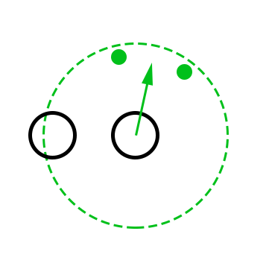
The Algorithm
Pattern-Seeking Vector
Reduce PKR
Robot-Repulsion Vector
Increase/ Reduce RSR
Sum Vectors
Scale Velocity
Notes:
Knowing all of this, we can now move into the root of the algorithm that assembles the velocity vector for a robot. When a robot finds data points within its pattern kernel radius (or PKR), it first creates a vector pointing towards the weighted average position of those points using the mean shift algorithm.

Slide 7
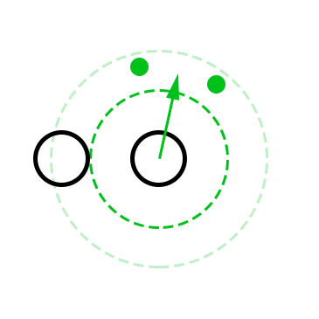
The Algorithm
Pattern-Seeking Vector
Reduce PKR
Robot-Repulsion Vector
Increase/ Reduce RSR
Sum Vectors
Scale Velocity
Notes:
Because data points were found within the robot’s PKR, it allows its PKR to shrink for the future timestep, so that the robot may focus on a smaller part of the pattern.

Slide 8
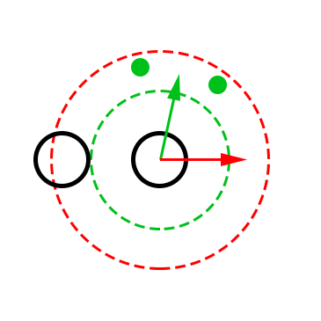
The Algorithm
Pattern-Seeking Vector
Reduce PKR
Robot-Repulsion Vector
Increase/ Reduce RSR
Sum Vectors
Scale Velocity
Notes:
After this initial pattern-seeking vector is formed, a robot-repulsion vector is formed using a similar method. Instead of using the pattern points as data, the neighboring robots within the robot-sensing radius (RSR) are used in a mean shift calculation. Once this vector is calculated, it is negated so that it points in the opposite direction of the average neighbor position, thereby trying to point away from neighbors.

Slide 9
The Algorithm
Pattern-Seeking Vector
Reduce PKR
Robot-Repulsion Vector
Increase/ Reduce RSR
Sum Vectors
Scale Velocity
Notes:
If neighbors were detected, then the robot reduces its robot sensing radius, otherwise, the RSR would grow.

Slide 10
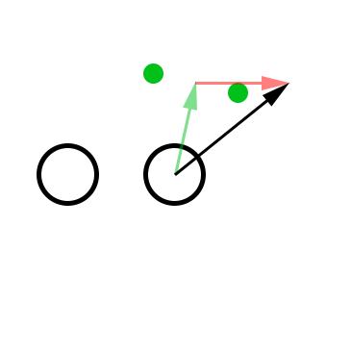
The Algorithm
Pattern-Seeking Vector
Reduce PKR
Robot-Repulsion Vector
Increase/ Reduce RSR
Sum Vectors
Scale Velocity
Notes:
Now we have both a pattern-seeking vector and a robot-repulsion vector. These can be summed together to get a vector that points in the desired direction of movement.

Slide 11
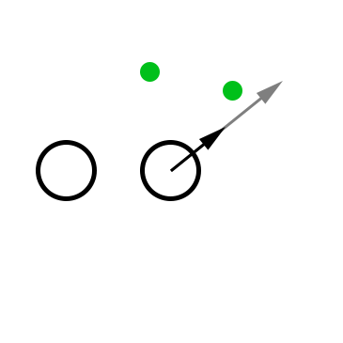
The Algorithm
Pattern-Seeking Vector
Reduce PKR
Robot-Repulsion Vector
Increase/ Reduce RSR
Sum Vectors
Scale Velocity
Notes:
Finally, this velocity vector is scaled to have a magnitude equal to the robot’s maximum speed. This means that when a robot moves, it moves by a user-defined distance..
This process leaves us with velocity vector that a robot will use during a given time step.

Slide 12
Scalability Test
Vary Number of Robots
10 robots
50 robots
100 robots
Notes:
For testing, we implemented our system as a simulation in MATLAB.
The first simulations we ran were testing the algorithm using a varying number of robots. 3 simulations were run, one with 10 robots, another with 50, and the last with 100 robots. In each simulation, robots begin in random positions throughout the environment, and as the simulation progresses, the goal is to see the group eventually assemble into a defined pattern.

Slide 13
Scalability Test Results
Notes:
Here is the first frame of all three simulations, with 10, 50, and 100 robots respectively.
The dots in the center of the environment make up the specified pattern. The larger blue circles each represent a robot. The large red circles represent an individual’s (robot sensing radius) used for detecting neighbors. Similarly, the green circles represent a robot’s pattern kernel radius, used for detecting pattern points.
Just a note here, also, is that the robots themselves are represented just as points, so the small blue circles do not describe the robot’s size.
You’ll notice that in all 3 simulations, the PKR and RSR of robots start with the same radius.

Slide 14
Scalability Test Results
Notes:
As we move through the first 125 frames, we can see that at this point, almost all robots have begun to approach the pattern, but not all robots have assembled on the pattern, yet.

Slide 15
Scalability Test Results
Notes:
After another 125 time steps, we can see that for the most part, all the simulated robots are on or are close to the defined pattern, though we can also see some areas of higher robot density on some parts of the pattern compared to other parts. For example we can see a higher density on the top-right of the ten robot simulation, and on the bottom left of the 50-robot simulation.

Slide 16
Scalability Test Results
Notes:
The end of the simulations show a more even distribution of robots, especially around the 10-robot simulation when compared to time step 250.

Slide 17
Scalability Test 50-Robot Video
Notes:
Here is a quick video of the 50-robot simulation.
As the simulation starts, we can see some robots move randomly and grow their PKR each time step because they do not detect any part of the pattern.
Once a robot’s PKR encounters the pattern, they begin the process described earlier, using mean shift to approach the pattern.
Also notice that the RSR of robots tends to decrease here, as they are moving towards the pattern because there is a high density of robots near the pattern.

Slide 18
Scalability Test Results
Notes:
Here we can see a more analytical approach to assessing the swarm’s performance. The red line indicates the average distance that each robot is from its closest pattern point, and the blue line denotes the average robot sensing radius of the swarm.
One of the first differences that we can see from this, is that the 10-robot swarm took longer to stabilize than the other two simulations. This is because the average RSR of the 10-robot group does not begin to level-out until closer to the end of the simulation when compared to the other two simulations. We can also see that the average distance from the pattern seemed to level-out at a low value in all 3 simulations, which tells us that, on average, the robots in each simulation ended fairly close to the pattern. We can see how the algorithm compensated for the increase in robots from the 50 and 100 robot simulations, as the average RSR of the 100 robot simulation ended lower than that of the 50 robot simulation. This lower RSR tells us that there was a higher density of robots assembling at the pattern when compared to the 50 robot swarm.

Slide 19
Other Tests
Large RSR increase
Small RSR decrease
Notes:
Because this has been implemented as a simulation, some other tests with varying parameters have been run, such as changing growth and decay rates of each robot’s PKR and RSR, as well as simulations varying the number of robots using a filled circle pattern. Varying these parameters in certain ways can lead to some interesting formation behavior.
For example, here we can see the result of a simulation where the RSR growth rate was high and the RSR decay rate was low. This leads to larger lingering RSR. This means that individuals can detect more neighbors, and when a robot detects more neighbors, then the robot repulsion vector begins to have a greater impact on the robot movement, which causes a kind of dispersed look of the swarm around the pattern.

Slide 20
Conclusion
-Parallel robot movement
-Shows promise of scalability
-Modular robot parameters
Notes:
From the simulations, we can see first of all that the robots move at the same time as one another. This helps the swarm make a fast initial formation at the pattern.
Because each robot does not need to calculate its desired final position (ie this is an iterative approach), we reduce the need of group-wide communication, and can keep the algorithm more based on local knowledge.
And because our study used simulation, we look forward to further assessing and testing variations in different robot parameters and patterns.
There are also other ideas that we would like to test eventually, such as a dynamic weights between the pattern seeking and robot-repulsion vectors
, such as PKR and RSR growth and decay rates, as well as how the process performs using different patterns.

Slide 21
Questions
Contact: chase.vickery@uky.edu
Notes:
Thank you for listening. Are there any questions?

Slide 22
Appendix 1 (Filled Circle Pattern)
Notes:
The 10-robot simulation took longer to stabilize than the other two

Slide 23
Appendix 2 (Filled Circle Pattern)
Notes:
The 10-robot simulation took longer to stabilize than the other two

Slide 24
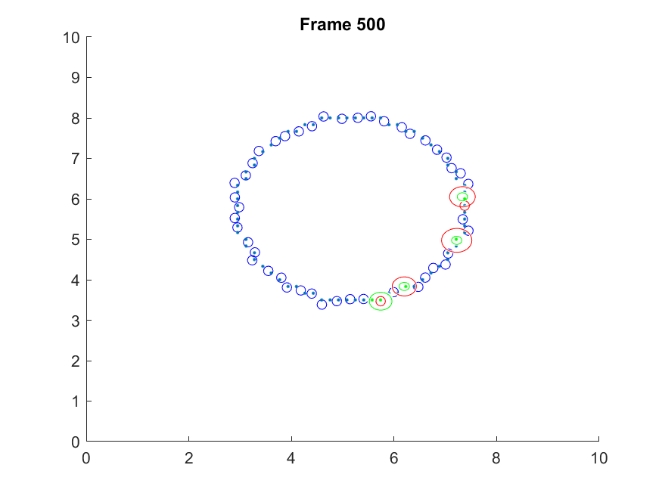
Appendix 3 (PKR Growth/Decay)
Notes:
Left= Low growth + high decay
Right = high growth + low decay (similar to original 50-robot test, but the initial pattern formed faster, because more pattern points in PKR means the pattern-seeking vector has a greater impact on robot movement).

Slide 25
References
- M. Schranz, M. Umlauft, M. Sende, W. Elmenreich, "Swarm Robotic Behaviors and Current Applications," Frontiers in Robotics and AI, April 2020.
- Y. Cheng, "Mean Shift, Mode Seeking, and Clustering," IEEE Transactions on Pattern Analysis and Machine Intelligence, vol. 17, no. 8, pp.790-799, August 1995.

